Slide 1
Intelligent Map Reader : A Framework For Topographic Map Understanding With Deep Learning And Gazetteer
Ardra P V
Class no:15 S7 BTech CSE
Dept of CSE MACE Kothamangalam
September 28 , 2018

Slide 2
CONTENT
Intelligent Map Reader : A Framework For Topographic map understanding With Deep Learning and gazetteer
Introduction
Existing system
Faster RCNN
OCR Engine
Frame work for Map Reader
Separation of text units
Gazetteer
Map content understanding
Experiment result
Conclusion

Slide 3
INTRODUCTION
Intelligent Map Reader : A Framework For Topographic map understanding With Deep Learning and gazetteer
Robust approach for recognizing map text.
The intelligent map reader framework includes
Detection of map text
Separation of text units
character recognition
Map content understanding
It enable automatic and accurate understanding of the content of a map.

Slide 4
INTRODUCTION(contd...)
Intelligent Map Reader : A Framework For Topographic map understanding With Deep Learning and gazetteer
detection oh map text via deep learning.
Text recognition through Google Tesseract OCR engine
Gazetteer used for map content understanding
geographical index or dictionary

Slide 5
EXISTING METHOD
Intelligent Map Reader : A Framework For Topographic map understanding With Deep Learning and gazetteer
Not time consuming.
Text features are not directly readable by computer
Difficult to extract text units from the map background.
Large scale map text recognition is difficult

Slide 6
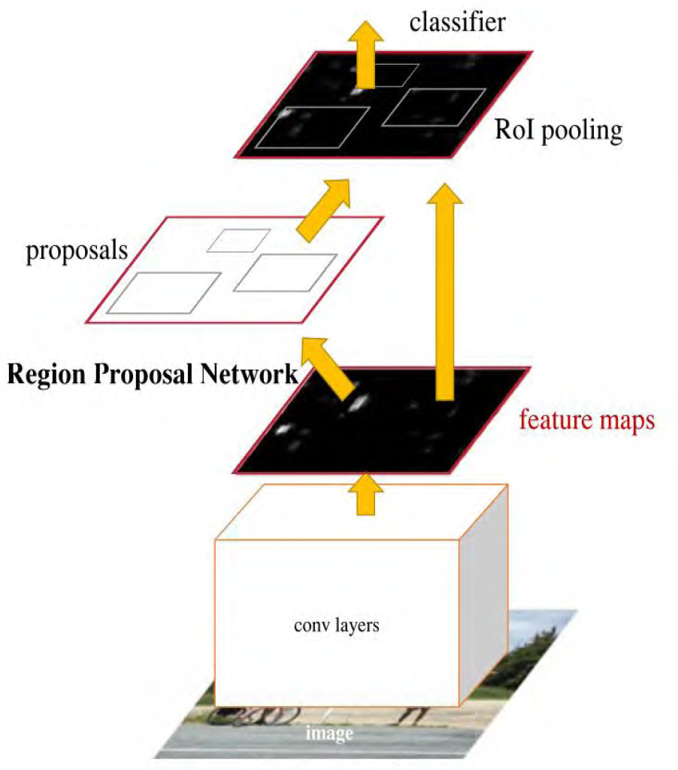
FASTER RCNN
Intelligent Map Reader : A Framework For Topographic map understanding With Deep Learning and gazetteer
Faster R-CNN is a deep convolution neural network
Developed based on the
architecture of fast R-CNN by adding RPN
Courtesy:https://ieeexplore.ieee.org

Slide 7
Intelligent Map Reader : A Framework For Topographic map understanding With Deep Learning and gazetteer
FASTER RCNN(contd...)
The loss fuction is defined
Floss (Pi,Bi)=
͟1 Σ Ldim(Pi,WPi) + ͟1 Σ Wpi . Lreg(Bi,WBi)
Ndim Nreg
WPi is one when i=+ve ,otherwise WPi is zero
Anchor box and aspect ration used to optimize position.

Slide 8
OCR ENGINE
Intelligent Map Reader : A Framework For Topographic map understanding With Deep Learning and gazetteer
The Google Tesseract OCR engine
Open-source engine .
Supports the recognition of text information .
OCR engine follows the process
Text line detection
Word extraction
Word recognition.
Tesseract 2 support 100 languages.

Slide 9
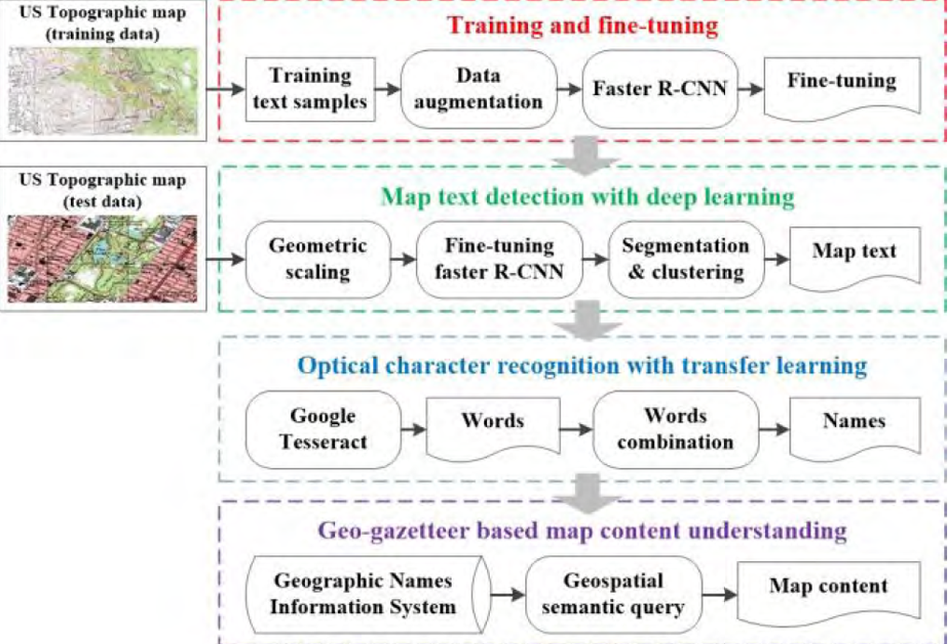
Intelligent Map Reader : A Framework For Topographic map understanding With Deep Learning and gazetteer
FRAMEWORK OF MAP READER
Courtesy:https://ieeexplore.ieee.org

Slide 10
TRAINING DATA SELECTION
Intelligent Map Reader : A Framework For Topographic map understanding With Deep Learning and gazetteer
Selection of text samples
Partitioned topographic map into sub images
Label Img to label the positions of words and terms.
Total number of labelled samples was 10200
Data augmentation
Rotations and random cropping.

Slide 11
MAP TEXT DETECTION
Intelligent Map Reader : A Framework For Topographic map understanding With Deep Learning and gazetteer
Map text unit is regarded as an object in image.
Faster R-CNN is for localization and recognition of text units
key parameters include the
Dimensionality of the anchor boxes
Aspect ratios
IoU in the loss function
the anchor box sizes are 64∗64, 128∗128, and 256∗256
the aspect ratios are 1:1, 1:2 and 2:1

Slide 12
MAP TEXT DETECTION(contd...)
Intelligent Map Reader : A Framework For Topographic map understanding With Deep Learning and gazetteer
The DCNN used in this study was a VGG Net model
The detection results on the entire map.
The red boxes indicate correct detection results.
purple boxes indicate false negative results.
Green boxes indicate false positive results.

Slide 13
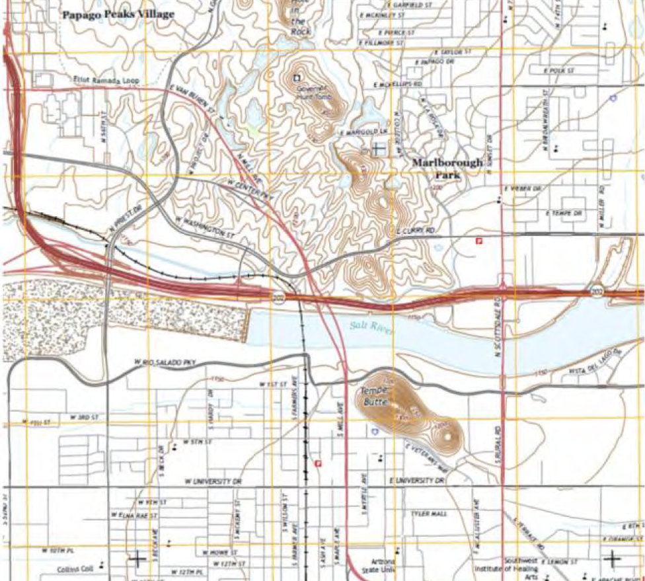

Slide 14
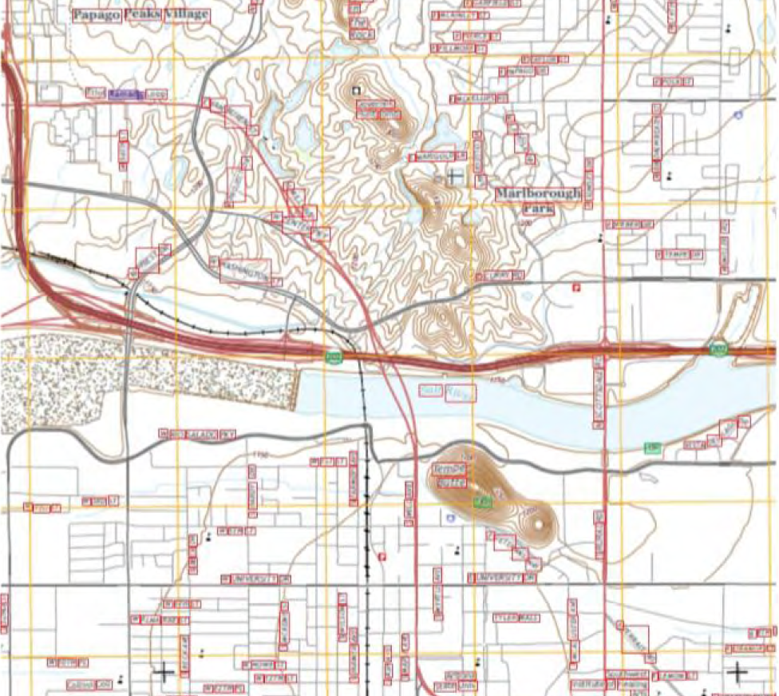

Slide 15
TEXT UNIT SEPERATION
Intelligent Map Reader : A Framework For Topographic map understanding With Deep Learning and gazetteer
Results should be separated from map background and noise
Graph-based segmentation for the detection area can be
G= D (V, E)
The graph-based segmentation partitions G into regions
gk = (V, Ek )
true , if diff(Ek1,Ek2)int_diff(Ek1,Ek2)
f (Ek1, Ek2) =
false, otherwise

Slide 16
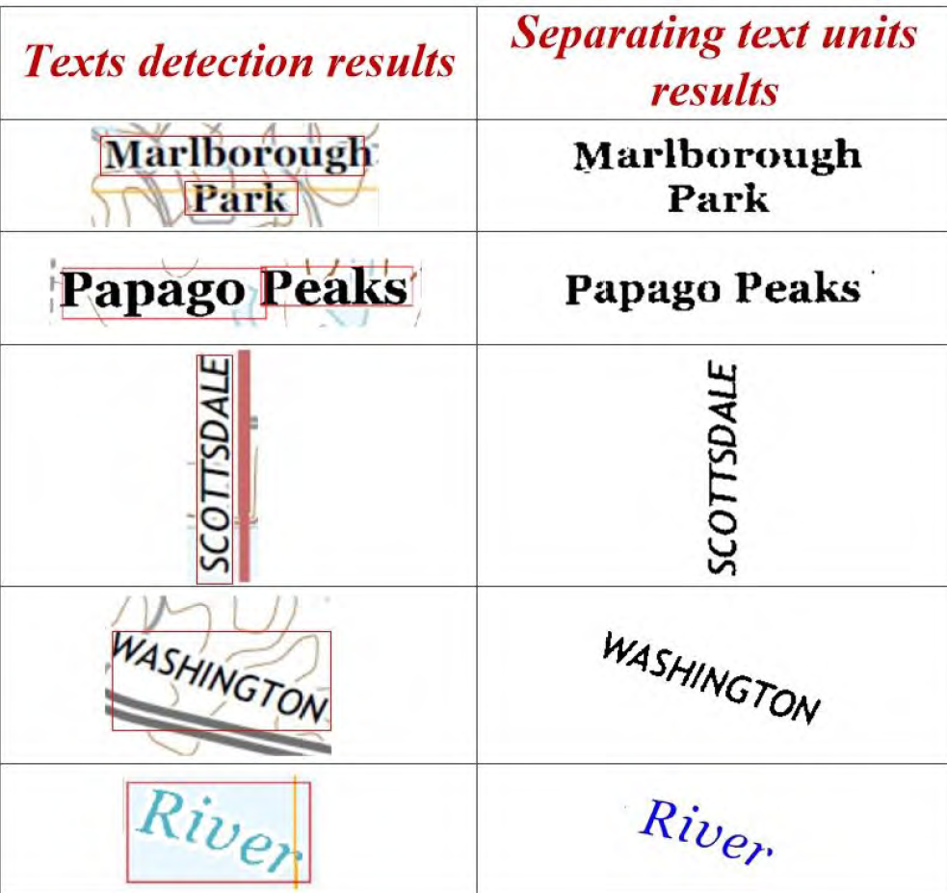
Intelligent Map Reader : A Framework For Topographic map understanding With Deep Learning and gazetteer
TEXT UNIT SEPERATION(contd...)
We cluster all segmented regions into multiple meaningful
groups
Courtesy:https://ieeexplore.ieee.org

Slide 17
TEXT UNIT SEPERATION(contd...)
Intelligent Map Reader : A Framework For Topographic map understanding With Deep Learning and gazetteer
We cluster all segmented regions into multiple groups
HSV colour space is normalized as a new 3D space.
DBSCAN to perform clustering on this new 3D space.
DBSCAN depends on two parameters
eps : maximal distances in terms of the HSV .
minPts : minimal number of samples.

Slide 18
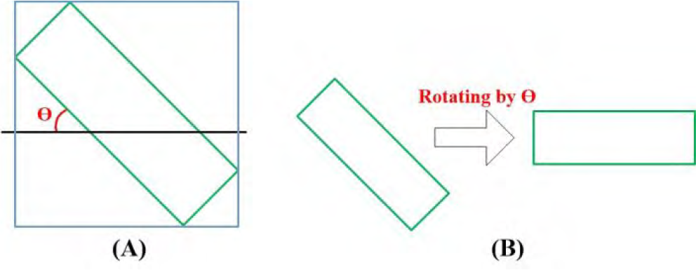
MAP TEXT IDENTIFICATION
Intelligent Map Reader : A Framework For Topographic map understanding With Deep Learning and gazetteer
To address oblique test ,use MBB method
[Xnew; Ynew; Z]^T = cosӨ , -sin Ө ,0
sin Ө, cos Ө, 0 [x,y,z]^T
0 , 0 , 1
Courtesy:https://ieeexplore.ieee.org

Slide 19
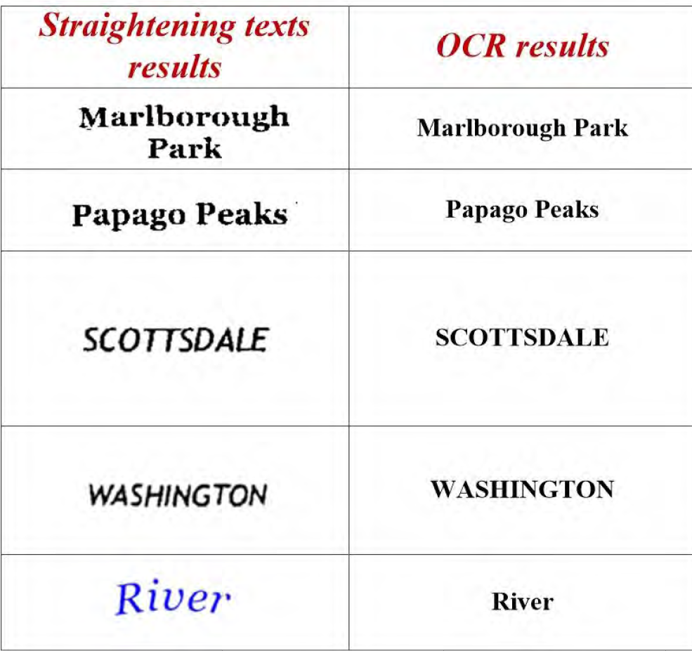
MAP TEXT IDENTIFICATION(contd..)
Intelligent Map Reader : A Framework For Topographic map understanding With Deep Learning and gazetteer
Then use OCR engine to detected
map text units.
Results are machine-readable text units .
Subjected to NLP and import into database.
Courtesy:https://ieeexplore.ieee.org

Slide 20
MAP CONTENT UNDERSTANDING
Intelligent Map Reader : A Framework For Topographic map understanding With Deep Learning and gazetteer
Based on digital gazetteer
Information included in gazetteer is
Place name
Geographical location/ features
Place description
GNIS system standardize the place names
Names of GNIS are organized as a hierarchy.
And support semantic queries.

Slide 21
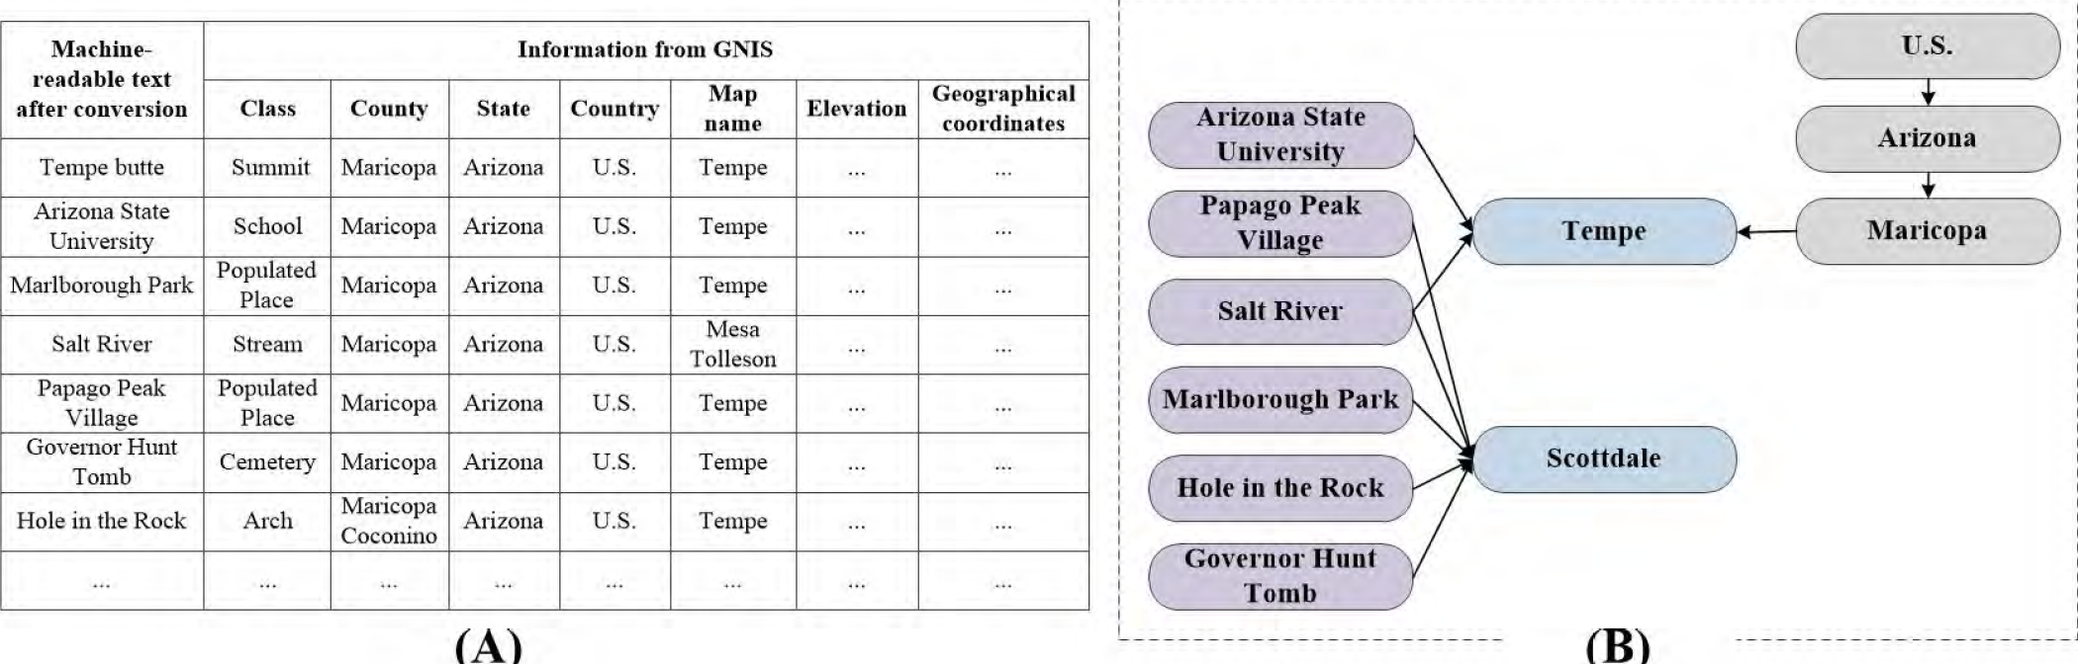
Intelligent Map Reader : A Framework For Topographic map understanding With Deep Learning and gazetteer
MAP CONTENT UNDERSTANDING(co..)
Courtesy:https://ieeexplore.ieee.org

Slide 22
EXPERIMENTS
Intelligent Map Reader : A Framework For Topographic map understanding With Deep Learning and gazetteer
Take 12 topographic map used to train faster RCNN
Which selected from deferent areas of US.
Provide average precision for detected map
AP value between 87% to 94%
AP Value at urban area is low
That of rural area is high

Slide 23
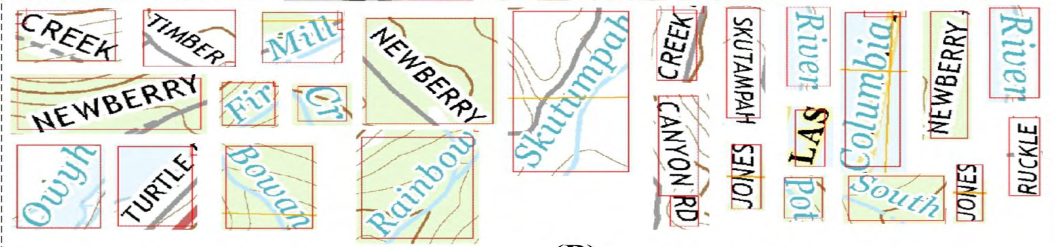
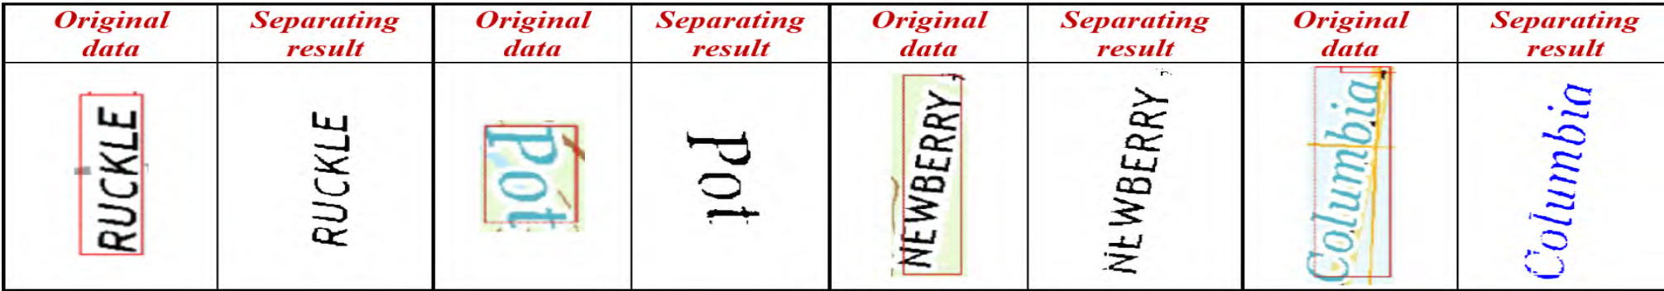
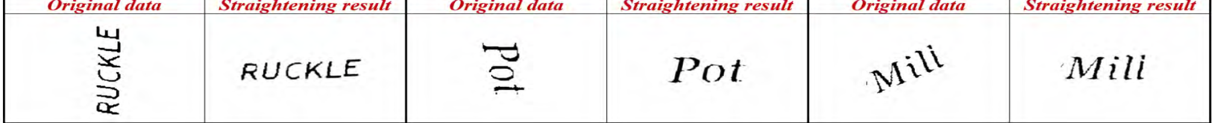
EXPERIMENTS(contd...)
Intelligent Map Reader : A Framework For Topographic map understanding With Deep Learning and gazetteer
Courtesy:https://ieeexplore.ieee.org

Slide 24
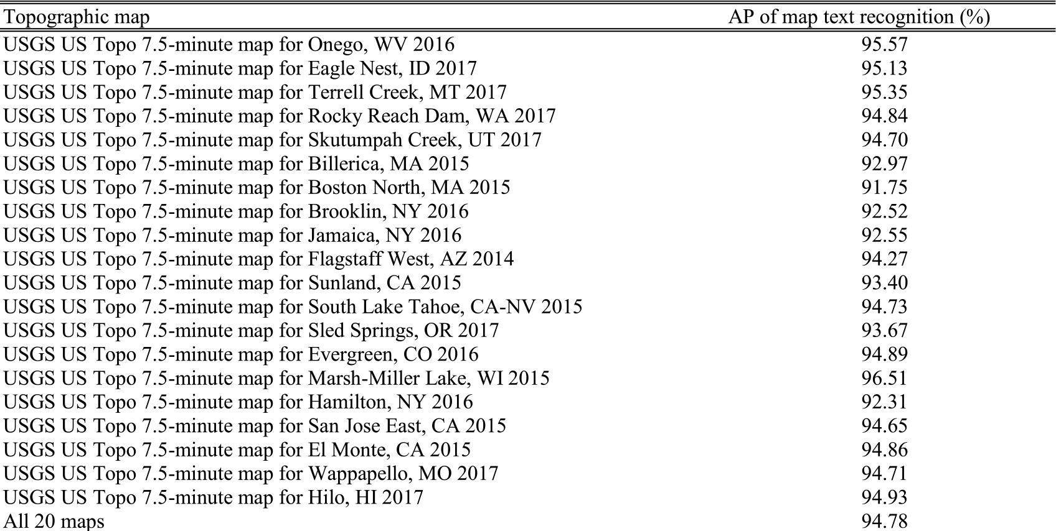
EVALUATION OF MAP TEXT
Intelligent Map Reader : A Framework For Topographic map understanding With Deep Learning and gazetteer
Courtesy:https://ieeexplore.ieee.org

Slide 25
RESULT OF MAP UNDERSTANDING
Intelligent Map Reader : A Framework For Topographic map understanding With Deep Learning and gazetteer
class, state, county and map name information for each phrase of map text
Some straightened text units might not be exactly horizontal , but OCR engine can identifying map text.
Tesseract achieved an accuracy of almost 100%.
USGS has established an ontology to provide access to dentitions of classes.

Slide 26
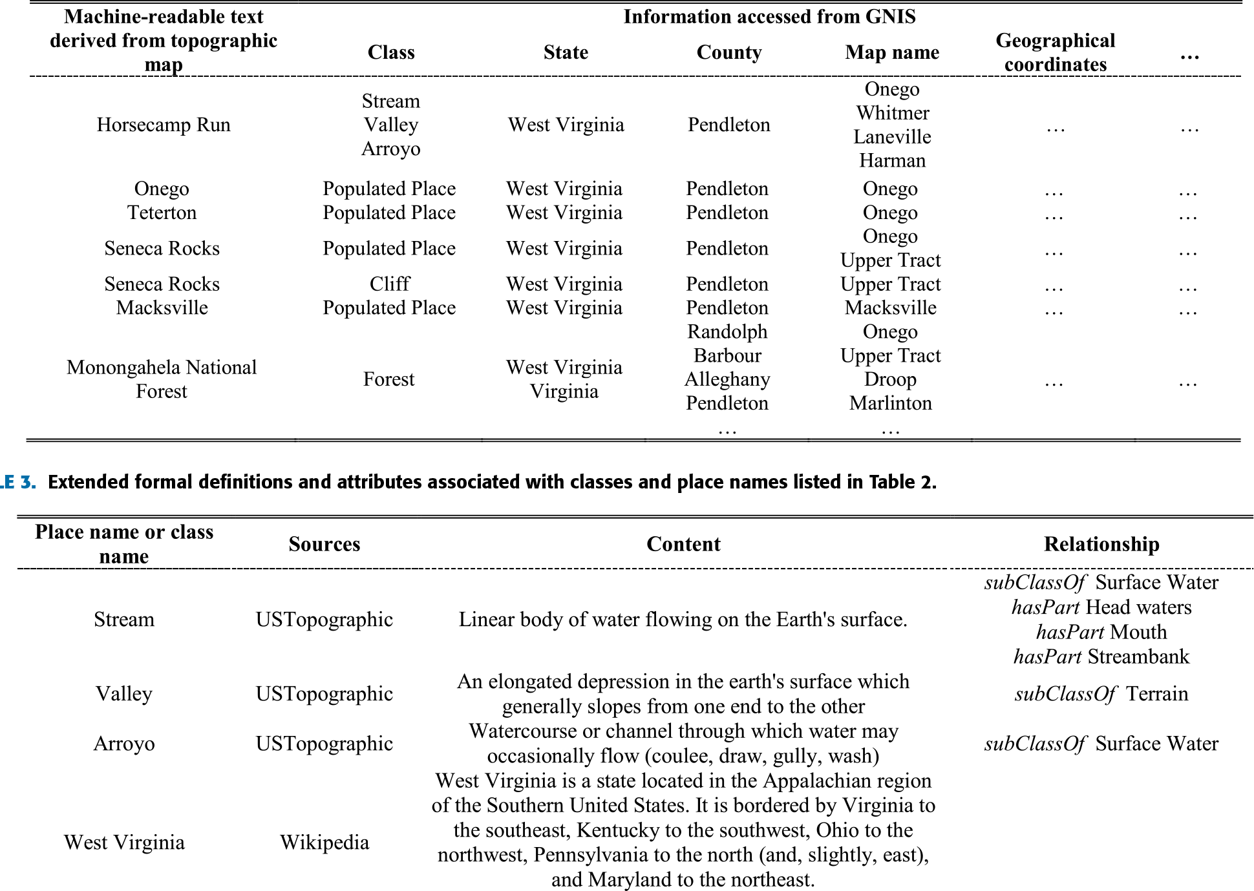
MAP UNDERSTANDING
Intelligent Map Reader : A Framework For Topographic map understanding With Deep Learning and gazetteer
Courtesy:https://ieeexplore.ieee.org

Slide 27
CONCLUSION
Intelligent Map Reader : A Framework For Topographic map understanding With Deep Learning and gazetteer
support the automatic understanding of the contents.
intelligent map reader is an applications in the GeoAI ﬁeld.
Plan to develop a new DCNN for joint map text detection and recognition.
It is a more efficient map reader.
Intelligent map reader is better than any other one.

Slide 28
REFERENCE
Intelligent Map Reader : A Framework For Topographic map understanding With Deep Learning and gazetteer
Pezeshk and R. L. Tutwiler, ‘‘Extended character defect model for recognition of text from maps,’’ in Proc. SSIAI, Austin, TX, USA, May 2010, pp. 85–88.
Pezeshk and R. L. Tutwiler, ‘‘Improved multi angled parallelism for separation of text from intersecting linear features in scanned topographic maps,’’ in Proc. ICASSP, Dallas, TX, USA, Mar. 2010, pp. 1078–1081
[3] A. Pezeshk and R. L. Tutwiler, ‘‘Automatic feature extraction and text recognition from scanned topographic maps,’’IEEETrans.Geosci.Remote Sens., vol. 49, no. 12, pp. 5047–5063, Dec. 2011.
M. P. Deseilligny et al., ‘‘Topographic maps automatic interpretation : Some proposed strategies,’’ in Proc. GREC, Nancy, France, 1997, pp. 175–193.
A.KhotanzadandE.Zink,‘‘Contourlineandgeographicfeatureextraction from USGS color topographical paper maps,’’ IEEE Trans. Pattern Anal. Mach. Intell., vol. 25, no. 1, pp. 18–31, Jan. 2003.

Slide 29
REFERENCE(contd...)
Intelligent Map Reader : A Framework For Topographic map understanding With Deep Learning and gazetteer
H. Wang and H. Yan, ‘‘Text extraction from color map images,’’ J. Electron. Imag., vol. 3, no. 4, pp. 390–396, Oct. 1994.
M.CaprioliandP.Gamba,‘‘Detecting and grouping words in topographic maps ,’’ in Proc. EUSIPCO, Tampere, Finland, Sep. 2000, pp. 1–4.
H. Yamada, K. Yamamoto, and K. Hosokawa, ‘‘Directional mathematical morphology and reformalized Hough transformation for the analysis of topographicmaps,’’IEEE,no.4, pp. 380–387, Apr. 1993.
Z.Lu,‘‘Detection of text regions from digital engineering,’’IEEE Trans. Pattern Anal. Mach. Intell., vol. 20, no. 4, pp. 431–439, Apr. 1998.
D. Dori and Y. Velkovitch, ‘‘Segmentation and recognition’’ Comput. Vis. Image Understand., vol. 69, no. 2, pp. 196–201, 1998.

Slide 30
Intelligent Map Reader : A Framework For Topographic map understanding With Deep Learning and gazetteer
THANK YOU...

